Slide 1
Goal Programming

Slide 2
In some situations, a decision maker may face multiple objectives, and there may be no point in an LP’s feasible region satisfying all objectives. In such a case, how can the decision maker choose a satisfactory decision? Goal programming is one technique that can be used in such situations.
Goal programming is a branch of multiobjective optimization

Slide 3
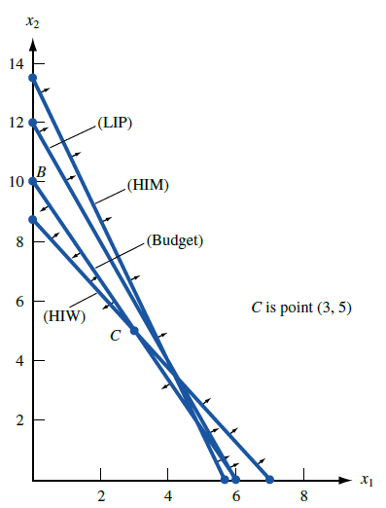
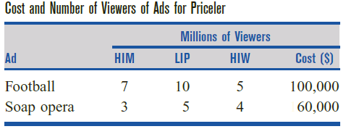

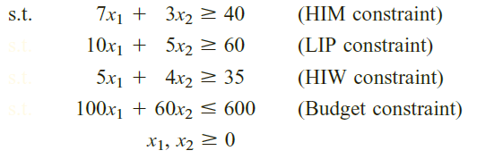

Slide 4
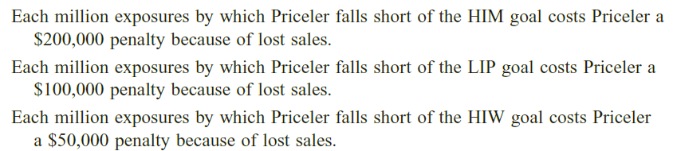
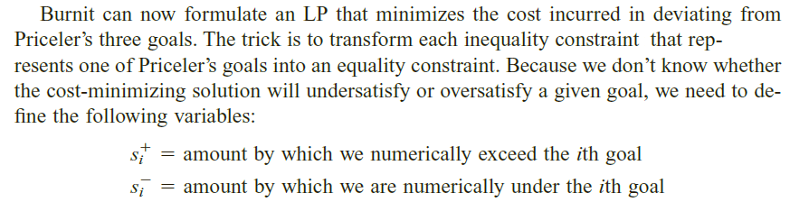
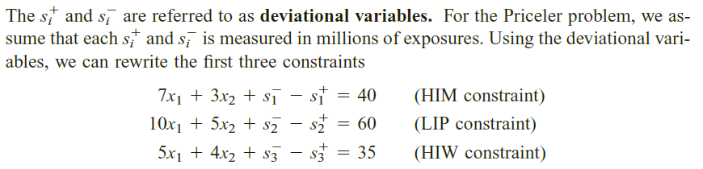

Slide 5
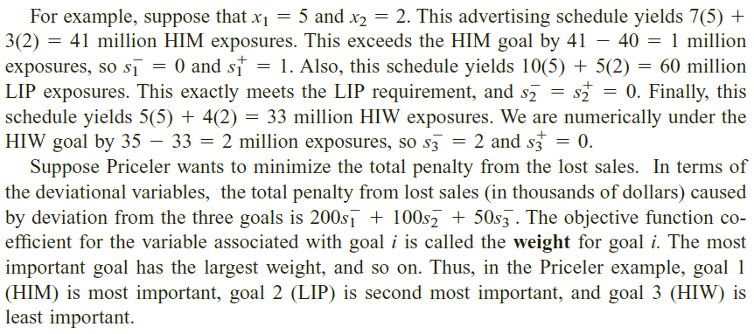
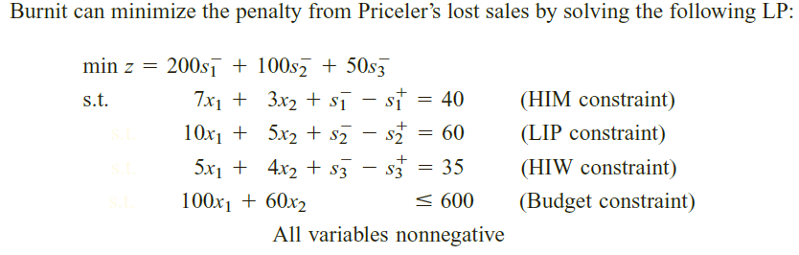

Slide 6
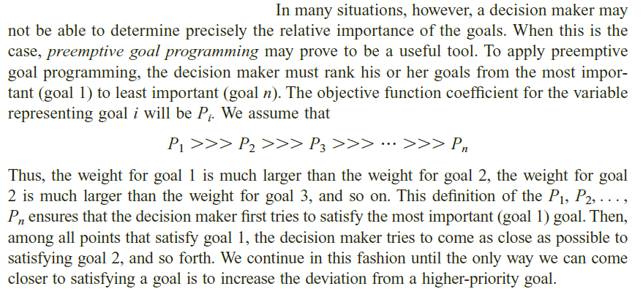
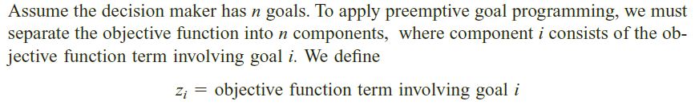
Preemptive Goal Programming

Slide 7
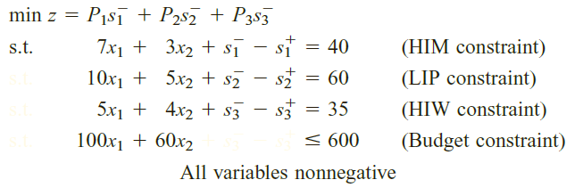
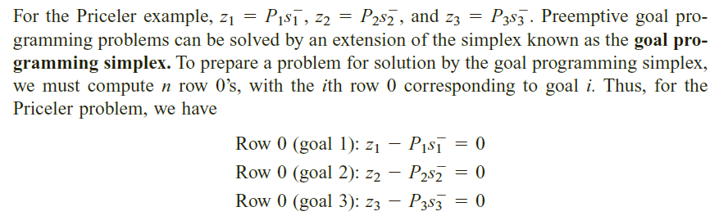

Slide 8
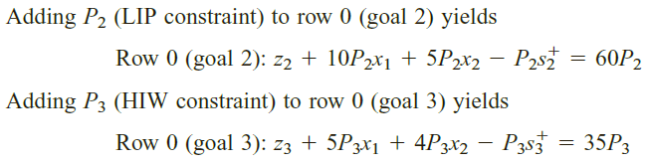
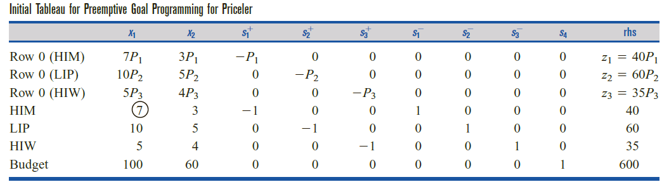

Slide 9
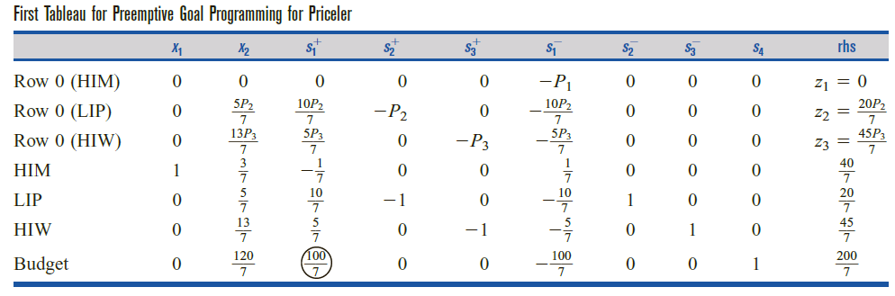

Slide 10
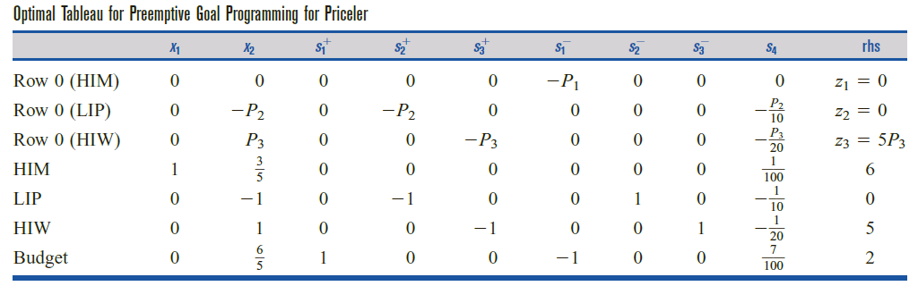
The preemptive goal programming solution is to purchase 6 minutes of football ads and no soap opera ads. Goals 1 and 2 (HIM and LIP) are met, and Priceler falls 5 million exposures short of meeting goal 3 (HIW).

Slide 11
